Slide 1
COVID_19 Global epidemic analysis
Cathy Li
1/07/2020

Slide 2
Background
Dec 2019, a pneumonia of unknown cause was detected in the city of Wuhan in Hubei province, China.
Jan 2020, the virus broke out in Wuhan which named Covid-19 by WHO.
Mar 2020, Covid-19 outbreaks in Italy and Spain.
Apr 2020, U.S. confirmed cases surged to 1 million.
Until Now, Covid-19 swept the world, total confirmed cases exceeds 10 million.
Notes:
Insert a map of your country.

Slide 3

DATA ACQUISITION
Many ways to get relevant Data
WHO
JOHNS HOPKINS
Other Open Source
https://github.com/CSSEGISandData/COVID-19
Notes:
Insert a picture of one of the geographic features of your country.

Slide 4
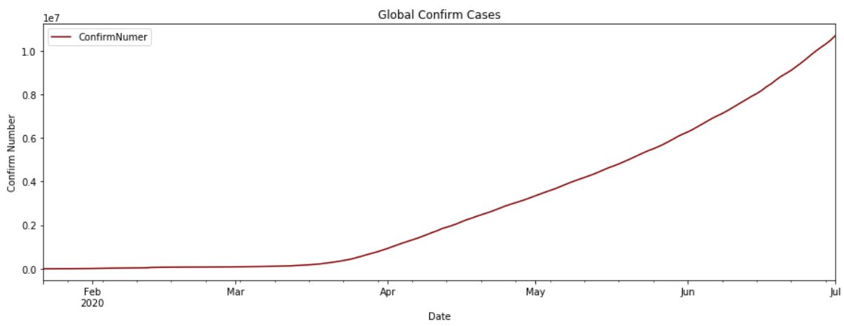
Global Confirm Trend Map
Global Confirm Number 11,088,671, 4th July 2020.
From 22/1/2020 to 1/7/2020
Notes:
Insert a picture illustrating a season in your country.

Slide 5
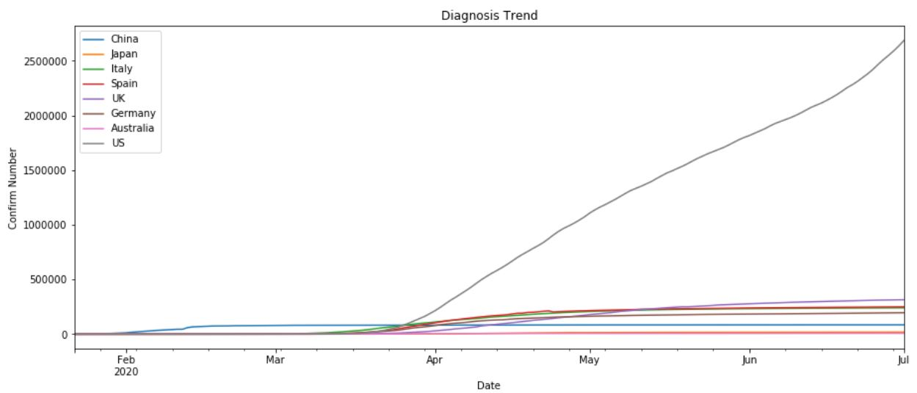
Several typical countries trend map
Eight Countries from different Continents
From 22/1/2020 to 1/7/2020
Notes:
Insert a picture of an animal and or plant found in your country.

Slide 6
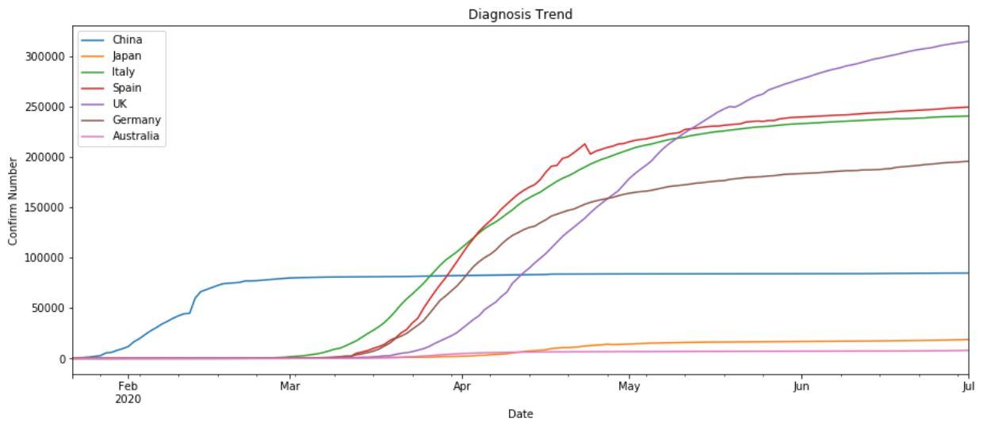
Several typical countries trend map
Remove US in order to get other countries clearly trend
Notes:
Insert a picture of an animal and or plant found in your country.

Slide 7
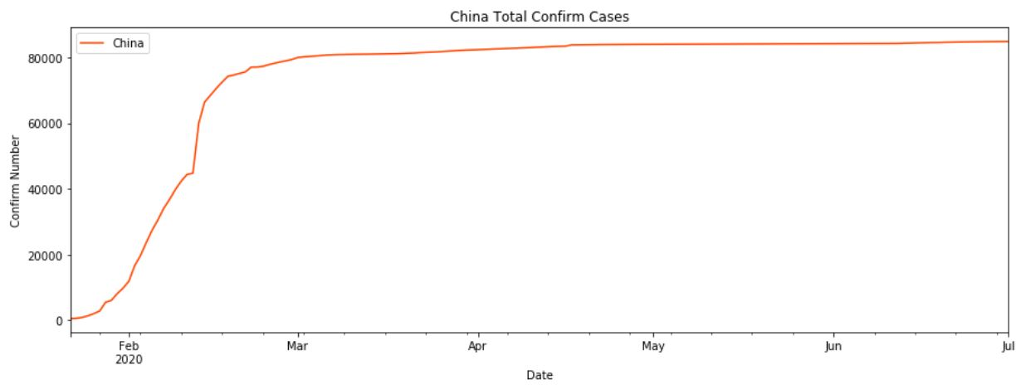
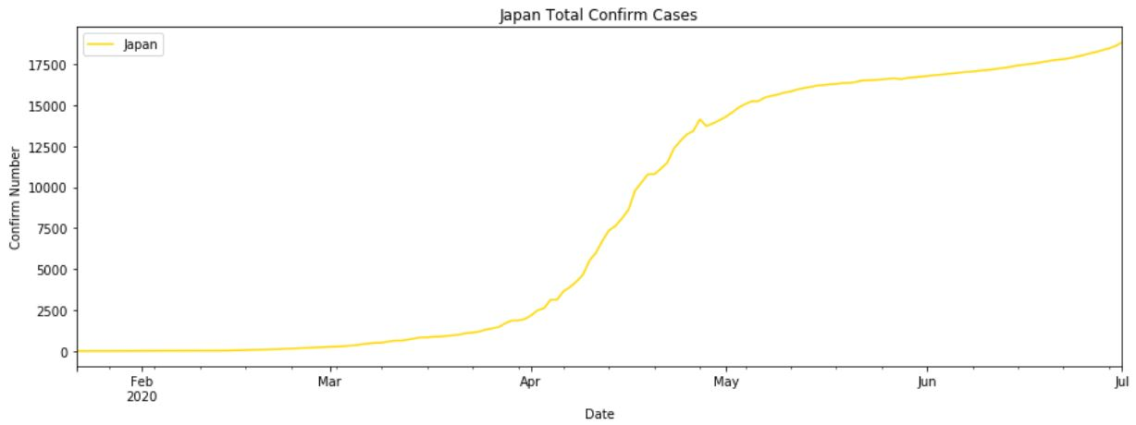
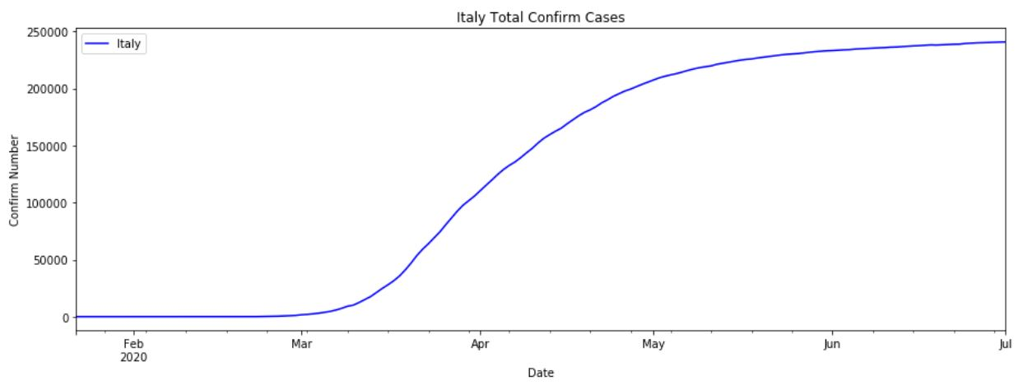
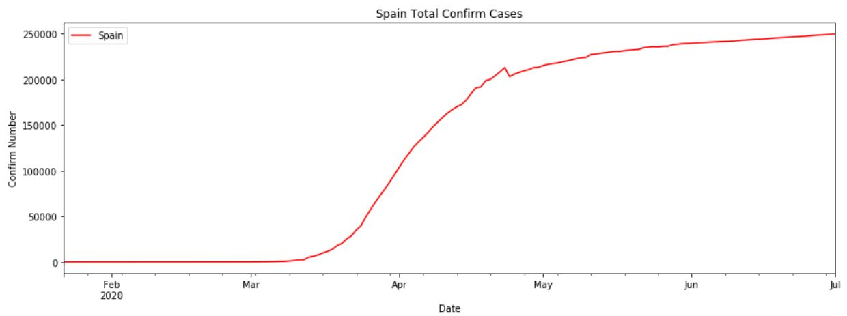
Trend map details
China, Japan, Italy, Spain; From 22/1/2020 to 1/7/2020
Notes:
Add key points in the history of your country to the timeline.

Slide 8
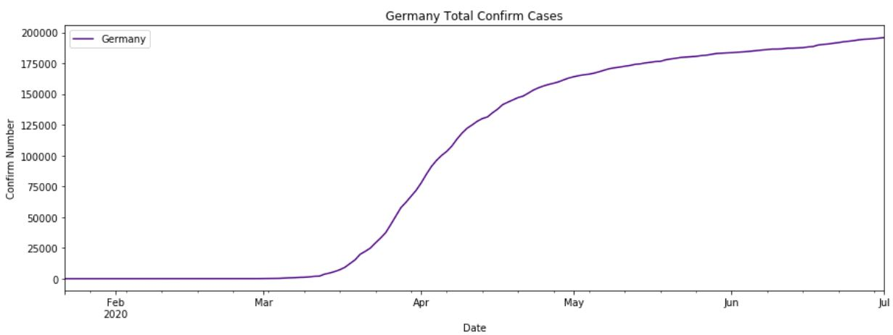
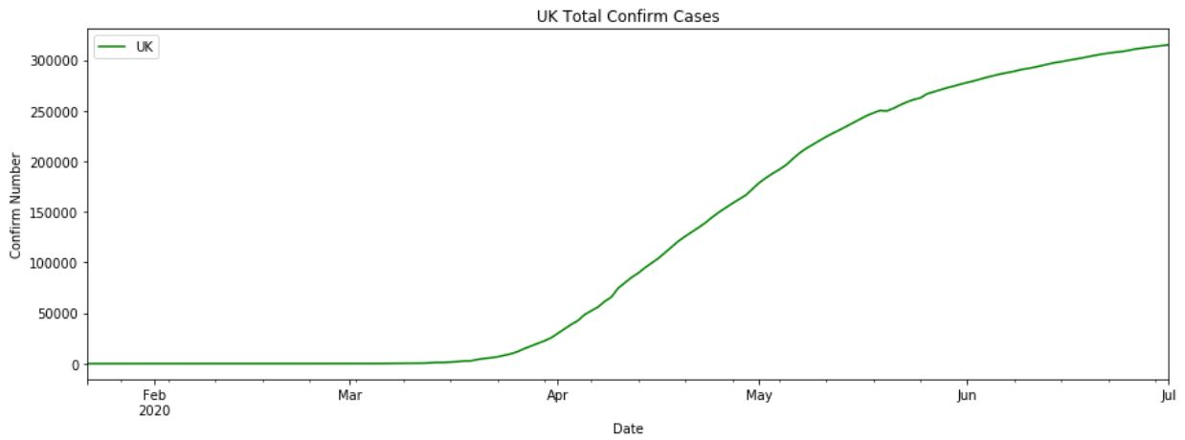
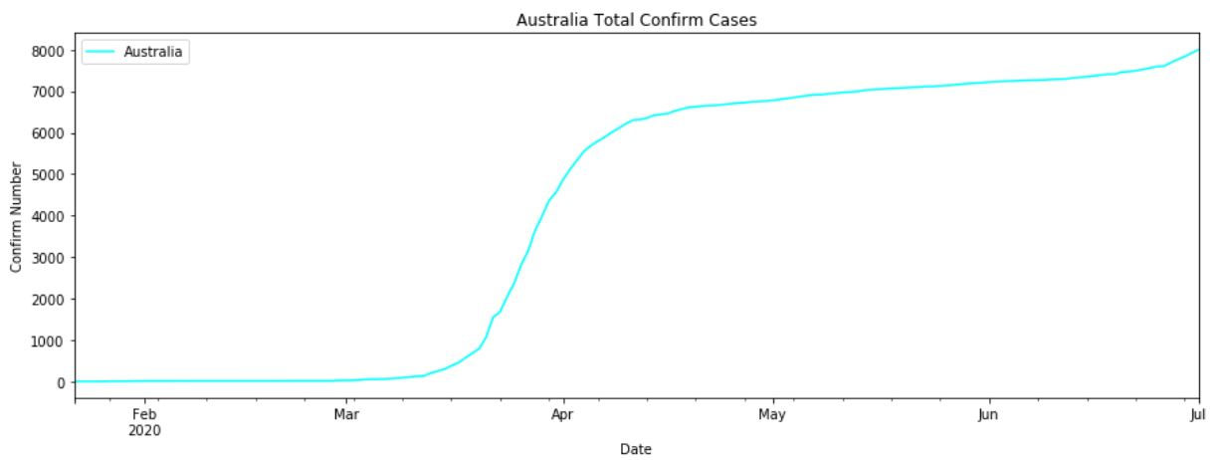
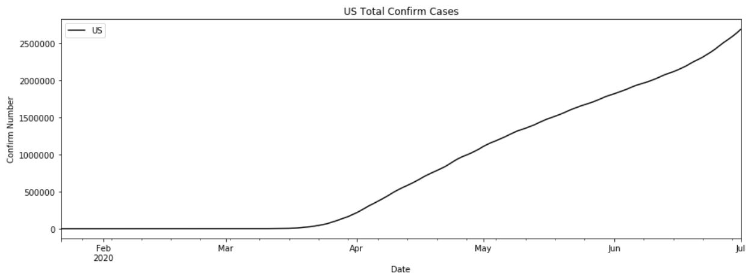
Trend map details
Germany, UK, Australia, US; From 22/1/2020 to 1/7/2020
Notes:
Add key points in the history of your country to the timeline.

Slide 9
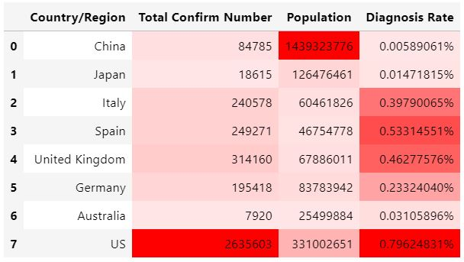
Diagnosis rate analysis
Replace China with Hubei.
Replace U.S. with New York.
Because there’s population are too large to do comparative analysis.
From 22/1/2020 to 30/6/2020
Notes:
Insert a picture illustrating a custom or tradition here.

Slide 10
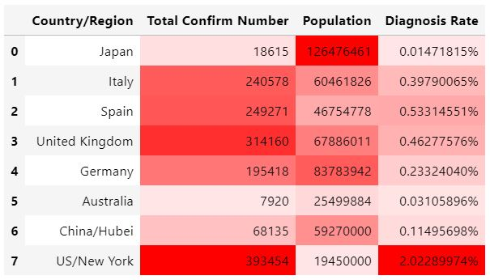
Diagnosis rate analysis
Japan has the lowest Diagnosis Rate with largest population.
Australia has the lowest Confirm Number.
NY ranks first in Confirm Number and Diagnosis Rate.
From 22/1/2020 to 30/6/2020
Notes:
Insert a picture illustrating a custom or tradition here.

Slide 11
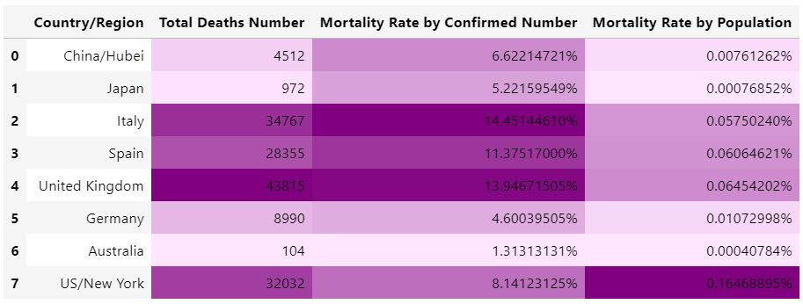
Mortality rate analysis
From 22/1/2020 to 30/6/2020
Notes:
Insert a picture illustrating a custom or tradition here.

Slide 12
Mortality rate analysis
Rank-1 (MR/C<=5%)
Australia and Germany
Rank-2 (5%< MR/C <=10%)
Hubei/China, Japan and New York/US
Rank-3 (MR/C >10%)
Italy, Spain and UK
Conclusion:
Japan and Australia did the best job at controlling coronavirus spreading.
Germany and New York, US also in good performance even they has a big amount confirmed cases, it shows their adequate medical resources.
Notes:
Insert a picture illustrating a custom or tradition here.

Slide 13
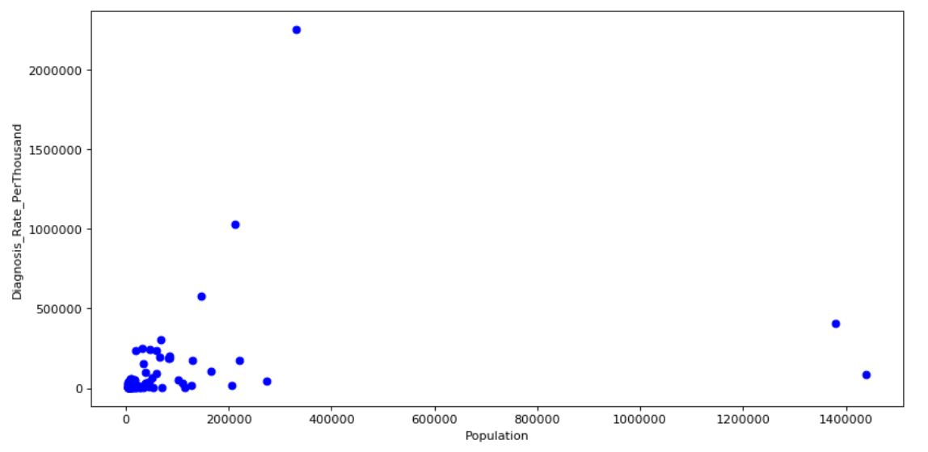
Predict Model -knn
K-Nearest Neighbors is an algorithm for supervised learning. Where the data is 'trained' with data points corresponding to their classification. Once a point is to be predicted, it takes into account the 'K' nearest points to it to determine it's classification.
Feature Not Fit
Linear Regression
None LinearRegression
Clustering
Notes:
Insert a picture of the head leader of your country.

Slide 14
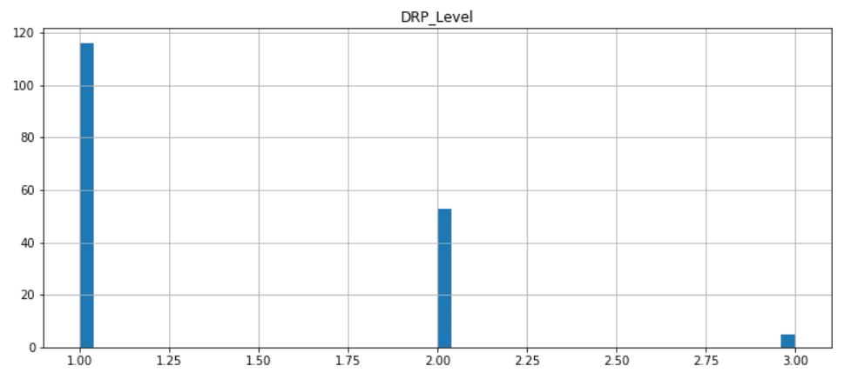
Predict Model -knn
Import Feature – DRP Level
*Diagnosis Rate Per Thousand Level
Level-1, DRP <=1
Level-2, 1<DRP <=10
Level-3, DRP>10
Notes:
Insert a picture of the head leader of your country.

Slide 15
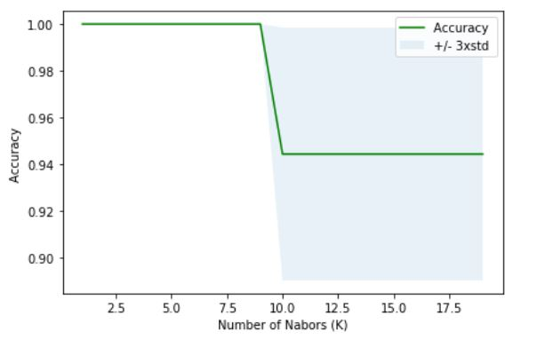
Predict Model -knn
Calculate Best K
It’s obvious that the best K’s range are in 0 to 10 from the figure, here I’ll take the median k = 5.
KNN models accuracy while
k = 5:
Train set Accuracy: 0.9615384615384616
Test set Accuracy: 1.0
Notes:
Insert a picture that illustrates some part of your country’s economy.

Slide 16
Model Prediction - US
Use this Model to predict U.S.
Sample: 52 states of U.S.
Not Matching Data: 12 states
Test set Accuracy: 0.7692307692307693
Not Matching Data Real DRP as below:
Notes:
Insert a picture of one of the points of interest for your country.

Slide 17
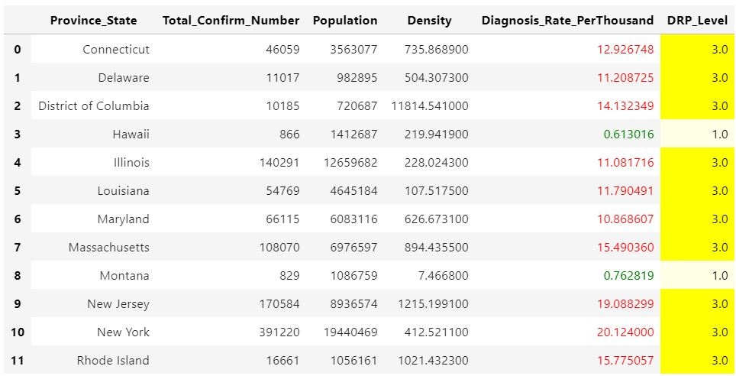
Model Prediction - US
Notes:
Insert a picture of one of the points of interest for your country.

Slide 18
Model Prediction - China
Use this Model to predict China
Sample: 33 Provinces
Only 1 Province meet predict result – Hubei (*first outbreak region)
Others Province/Region all lower than predict DRP Level
Partial of Not Matching Data Real DRP as below:
Notes:
Insert a picture of one of the points of interest for your country.

Slide 19
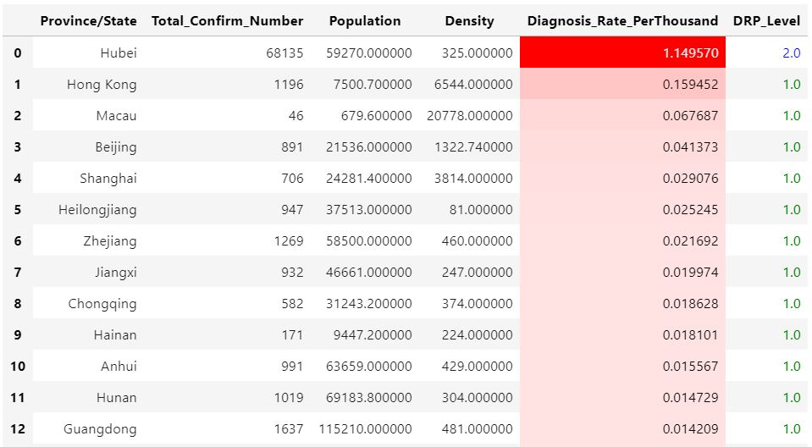
Model Prediction - China
Notes:
Insert a picture of one of the points of interest for your country.

Slide 20
Conclusion
Covid-19 is a global healthy crisis, must be taken seriously.
Herd Immunity is definitely unfeasible, we can’t afford the price at all.
Lock down city is a good way to slow down it’s spreading.
Wearing masks and Social distancing are the simplest and most effective way that we can do to saving lives.
At last, hope everyone is safe.
Thanks
Notes:
Insert a picture of one of the points of interest for your country.

